Slide 2
Moving Advanced Analytics to your SQL Server Database
Enrico van de Laar

Slide 3

About
Enrico van de Laar
Data & Advanced Analytics Consultant @ Dataheroes
Crazy Data Scientist
Microsoft Data Platform MVP
Author
Speaker
Blogger
Twittter: @evdlaar
Email: enrico@Dataheroes.nl
Blob: https://www.enricovandelaar.com

Slide 4
Plan for this session
Advanced Analytics Worflow: then and now
Building and exploiting in-database models
sp_execute_external_script
sp_rxPredict
PREDICT
Integration of Azure Machine Learning with in-database analytics

Slide 5
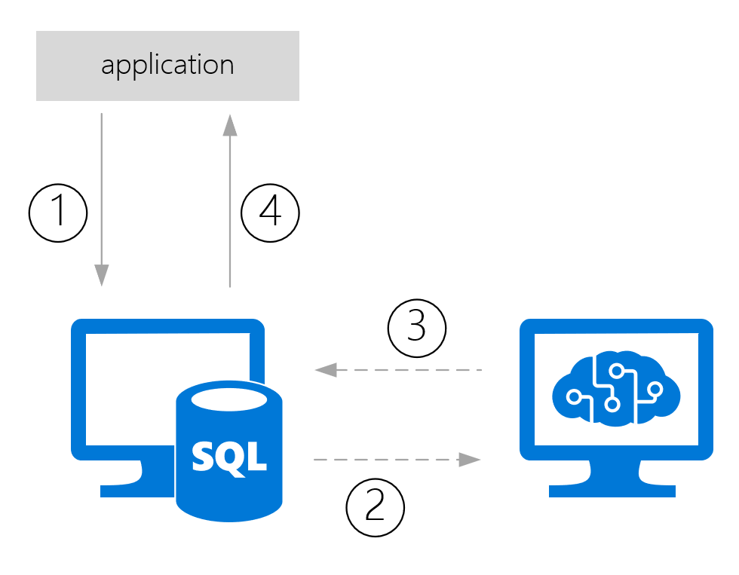
Advanced Analytics: then and now
Traditionally Advanced Analytics processes extracted data
That data would be used for model training/scoring and then send back to wherever it came from
Notes:
1: Data from app is stored in a database
2: Data is pushed/pulled to model
3: prediction is returned and stored with the data
4: prediction returned to app from database

Slide 6
Advanced Analytics: then and now
This process can be slow, especially when large datasets are involved
There is always data movement involved
How are we solving use-cases where (near) real-time scoring is required?
How are we handling model management and operationalization?

Slide 7
Demo
Traditional model scoring

Slide 8
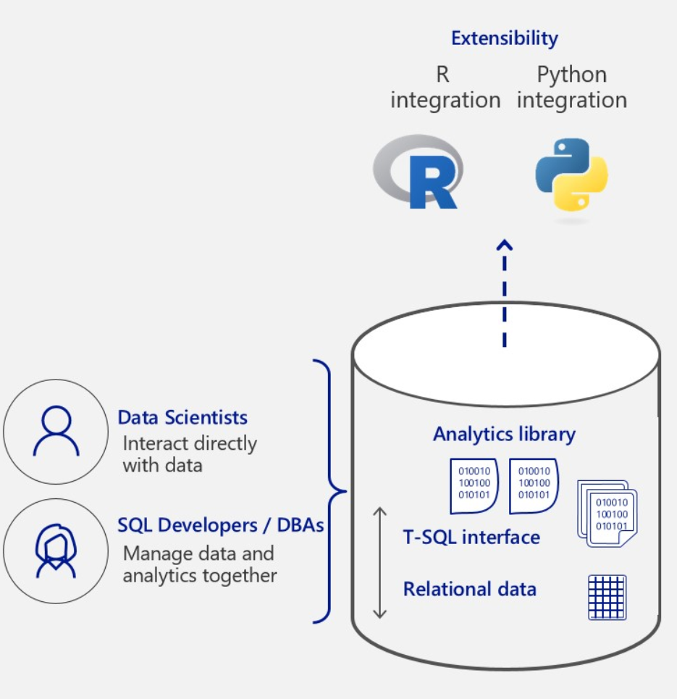
Advanced Analytics: then and now
The solution: “in-database” analytics
New feature in SQL Server 2016 (R Services In-database)
Expanded in SQL Server 2017 & 2019 (Machine Learning Services In-database & inclusion of Java)
Instead of bringing data to the model, we are bringing the model to the data
Notes:
2016 Introduced R support
2017 Expanded with Python
2019 Java support
Advantages: No data movement, model management integrated in SQL Server, direct access to data

Slide 9
Building and exploiting in-db models
Three methods available for model training and scoring
sp_execute_external_script (SQL Server 2016)
sp_rxPredict (SQL Server 2016)
PREDICT (SQL Server 2017)

Slide 10
Building and exploiting in-db models
sp_execute_external_script
Supports both R and Python
Not dependent on RevoScaleR or MicrosoftML algorithms
External process
Requires in-database R or ML feature
sp_rxPredict
Fast!
Only R support
Requires CLR integration
Only supports RevoScaleR or MicrosoftML Algorithms
Only returns predictions
Requires in-database R or ML feature
PREDICT
Supports both R and Python
Fast
Easy TSQL integration
Does not requires in-database R or ML feature
Only SQL Server 2017
Only supports RevoScaleR algoritms

Slide 11
Building and exploiting in-db models
Let’s take a closer look at how sp_execute_external_script works
Source: https://docs.microsoft.com/en-us/sql/advanced-analytics/concepts/extension-r
Notes:
The proces is more or less the same for Python (with different .dll files)

Slide 12
Demo
In-Database model training & scoring

Slide 13
Azure Machine Learning integration
But what do you do when your model is stored inside Azure Machine Learning, but your data is on-premises inside a SQL Server database?
We can use sp_execute_external_script to write R/Python code to perform a call to the AzureML predictive experiment!

Slide 14
Demo
Integrating Azure Machine Learning

Slide 15
Summary
We looked at the Advanced Analytics workflow and how in-databases analytics can impact it;
Build and stored a model directly in SQL Server;
Used the various methods to exploit the model and perform in-database predictions;
Connected to an Azure Machine Learning predictive experiment to score data inside SQL Server.

Slide 16
Questions?

